Slide 1
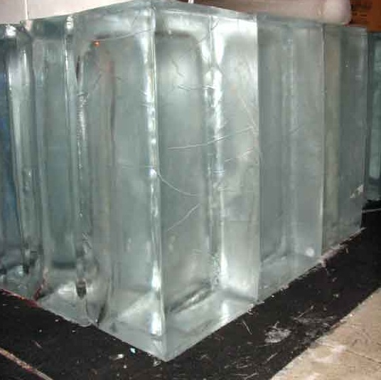
PRODUCT COUNTING SYSTEM USING RFID
POLARICE

Slide 2
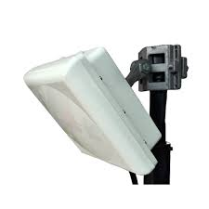
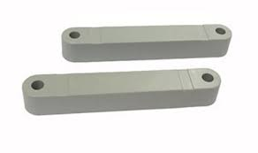
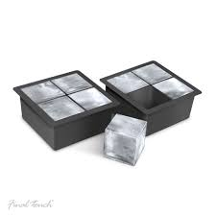
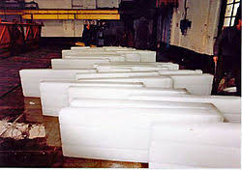
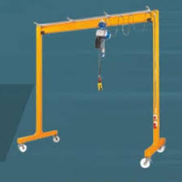
PROCESS FLOW
UHF INNOVA TAG
APPLIED INTO THE TOP SIDE OF THE TRAY
RFID ATTACHED TRAYS AFTER SOLIDIFICATION
REDING DATA PUSH TO THE SERVER
LIFT DROPES THE ICE TO THE DROP POINT WHICH IS FIXED WITH
F800 READER WITH 4 ANTENNAS
LIFTINFG THE TRAYS TO THE DROP POINT WITH THE HELP OF CRANE
STALLION SERVER

Slide 3
CHALLENGES
The ice tray’s immersed with Salt water during the solidification process.
Ice tray’s are made up of metal
Readers are mounted into water falling area

Slide 4
ADVANTAGES
Automated counting
Reduce manpower
Data transfer to the server for cross checking procedure
Easy to track the tray

Slide 5
PRODUCTS USED
ALIEN F800 MULTIPORT READER
STA 86609C CIRCULAR POLARISED ANTENNA
STA UHF INNOVA TAG

Slide 6
VIDEO

Slide 7
THANK YOU
PRESENTER NAME:PRAMOD C
CUSTOMER NAME:POLARICE

